Slide 1
Nonresident Alien - Tax Presentation
Presented by Tax Department
Alma Villarreal (Tax Assistant)
Elizabeth Giron (Foreign National Tax Specialist)

Slide 2
How to Reduce or Stop Tax Withholding Process
Step 1
Complete Foreign National Tax Information Form provided by your hiring official
Submit copies of your immigration documents to your department or Human Resources to be photocopied. If neither HR nor your department request this information from you, please notify the Tax Department by email (egiron@central.uh.edu) immediately. Please include PeopleSoft ID Number in your email correspondence.
Step 2
Logon to Foreign National Information System (FNIS)
After packet and copies of documentation are received by the Tax Department, you will receive an email that contains website & user information. You must enter the required data.
Step 3
Tax Analysis
The data you have entered is reviewed and approved, a tax analysis is completed. The results will determine what, if any, tax treaty exemption benefits you may be eligible for.
Step 4
Signing of Tax Forms
If you are eligible for federal income tax treaty benefits, you will receive an email indicating IRS tax exemption forms are available on your FNIS account.
Step 5
Tax Exemptions Applied to Payroll
All tax exemptions are applied to payroll, you will notice a reduction in taxes in approximately 2 pay cycles.

Slide 3
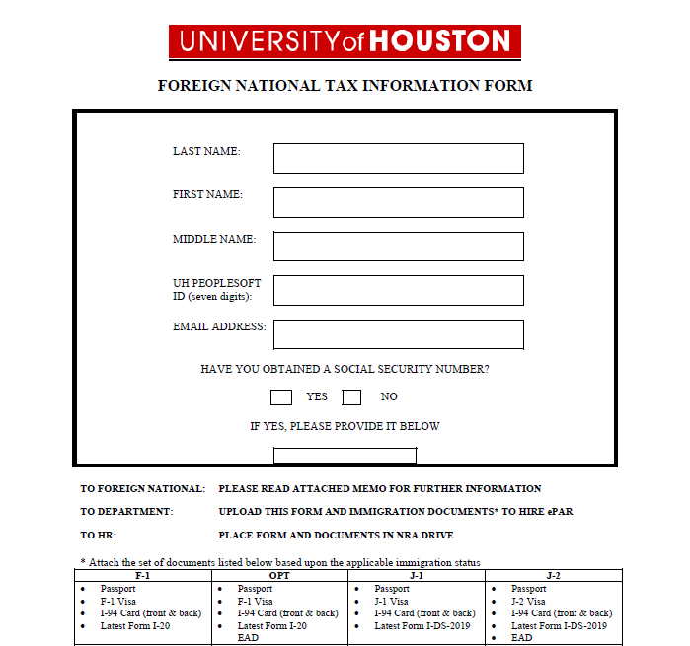
Step 1
Fill out the Foreign National Information Form
You should receive this form from your hiring official.
If you do not, please send me an email egiron@central.uh.edu.

Slide 4
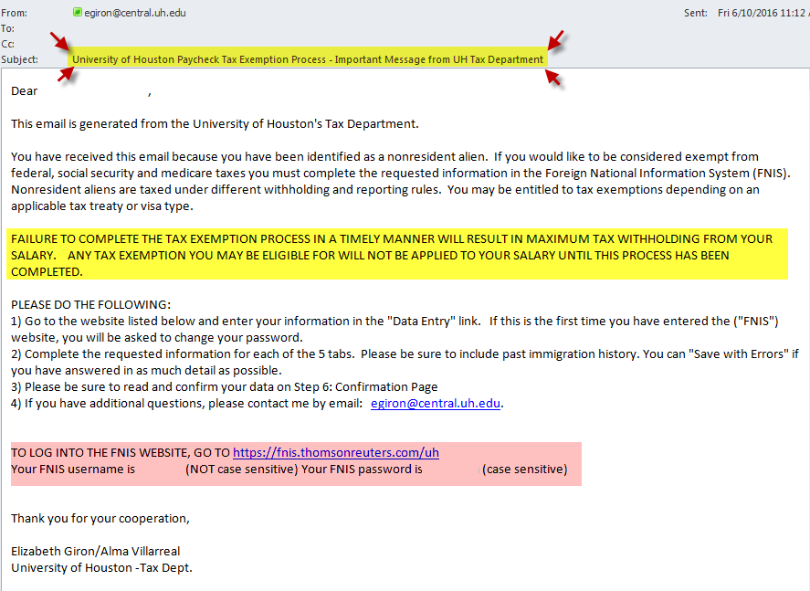
After the packet is received by the Tax Department, you will receive the following email. (You must use the criteria below to logon and access the Foreign National Information System.)
Step 2
DO NOT DISREGARD THIS EMAIL, YOU WILL NOT RECEIVE A REMINDER!

Slide 5
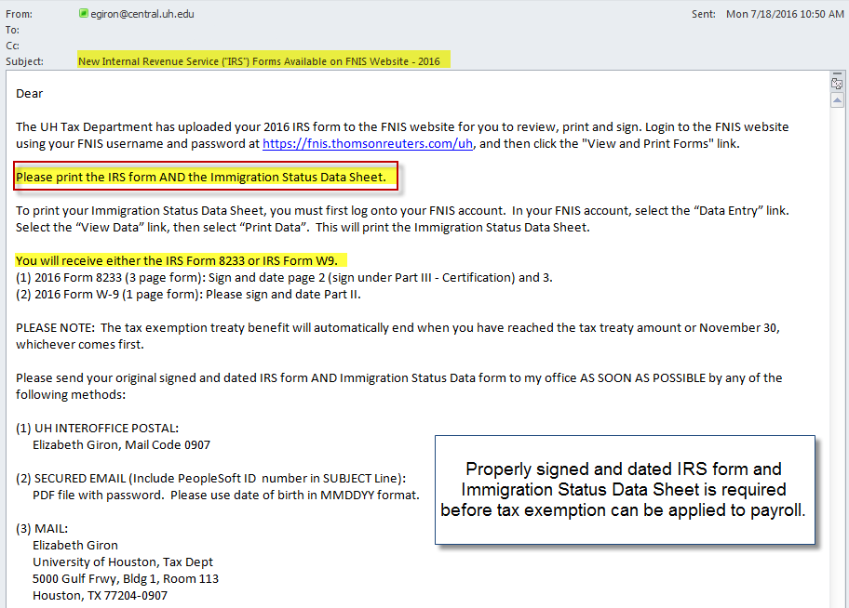
After completing the tax analysis, if it is determined you are eligible for exemption from federal income tax – you will receive the following email:
Step 3

Slide 6
Step 4
Signing of Tax Forms
If you are eligible for federal income tax treaty benefits, you will receive an email indicating IRS forms are available on your FNIS account. To ensure the exemptions are applied to your payroll, please carefully follow the instructions in the email.
The most common mistakes include improperly signing the IRS 8233 tax form and not sending the Immigration Status Data Sheet.

Slide 7
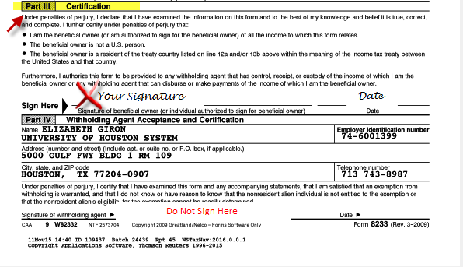
IRS Form 8233, page 2
continued

Slide 8
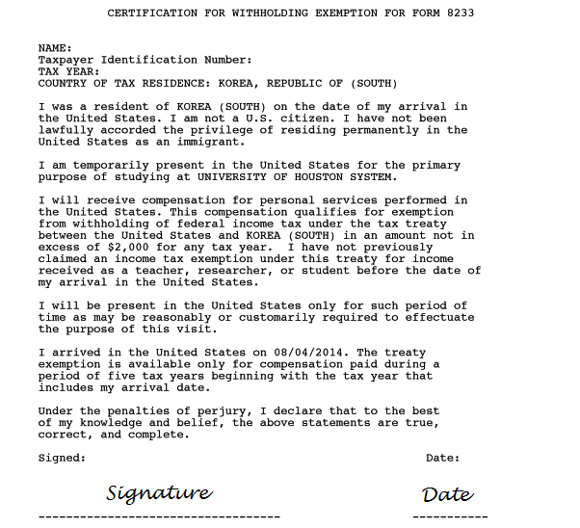
IRS Form 8233, page 3
continued

Slide 9
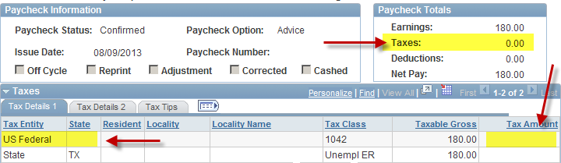
Step 5
Tax Exemptions Applied to Payroll
After the signed forms (IRS tax form and Immigration Status Data Sheet) are received by the Tax Department, the applicable tax exemptions are applied to your payroll. You will notice a reduction in taxes in approximately 2 pay cycles.

Slide 10
Following are the most frequently asked questions

Slide 11
What is a Nonresident Alien (NRA)?
U.S. tax term, not an immigration term (e.g. exchange visitor)
Student (F-1/J-1 visa holder) – First 5 “calendar” years from date of arrival in U.S.
Teacher/Researcher (J-1 visa holder) – First 2 “calendar” years from date of arrival in U.S.
After time limit exceeded, taxed as a U.S. citizen / resident alien (for tax purposes only)

Slide 12
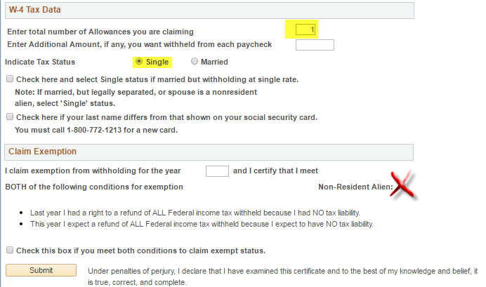
Default for all NRAs is Single with 1 Allowance (regardless of marital status). Select Non-Resident Alien. See example:
How do I Complete W4 on my P.A.S.S.?

Slide 13
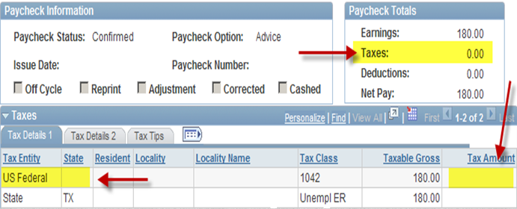
How can I tell if I am receiving federal income tax treaty benefits?
You will notice on your paystub there is no federal income tax withholding amount. You will remain exempt from this tax until you reach the tax treaty maximum or the calendar year ends (whichever comes first).

Slide 14
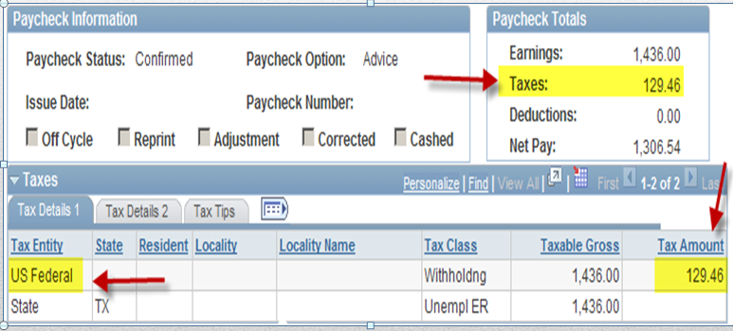
How can I tell if I am not receiving federal income tax treaty benefits or have reached my treaty maximum?
You will notice on your paystub there is an amount withheld for federal income tax.

Slide 15
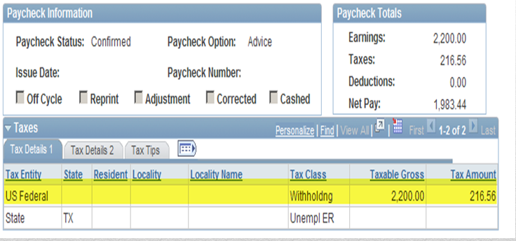
How can I tell if I am receiving exemption from FICA taxes?
You can refer to your paystub on P.A.S.S. You will only have Federal Income Tax withholding.

Slide 16
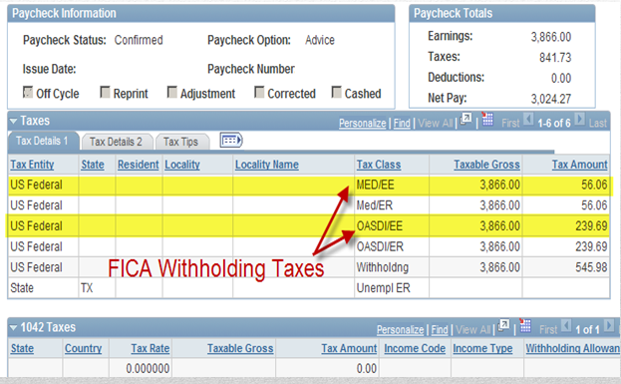
How can I tell if I am being charged FICA taxes?
You can refer to your paystub on P.A.S.S. These deductions are listed as OASDI/EE and MED/EE.

Slide 17
If I am a Nonresident Alien (usually F-1 or J-1 visa holder) in the United States (“U.S.”) and I have no U.S. income, will I be required to file a U.S. tax return?
Yes, even if you have no income, you MUST file IRS Form 8843. You may use the FNTR software provided by the ISSSO to process this form.

Slide 18
My friend does not pay any taxes. Why do I have to pay taxes if we are in the same situation?
Although, it may SEEM as if your situation is the same, there are many different facts and circumstances that would qualify one individual for tax exemption benefits and not another.
My friend used Turbo Tax Software. Can I use it too?
Unless you have determined you are a resident for tax purposes, you should NOT use Turbo Tax.

Slide 19
Is there someone who can help me with filing my tax return?
Employees at the University of Houston are not able to provide you with assistance in preparing your tax return. However, the University does offer the following tax preparation assistance at no cost to you:
VITA Program
(Volunteer Income Tax
Assistance Program)
Certified Public Accountants in the Houston area and UH graduate business students volunteer to help prepare/review NRA tax returns at no cost to you. Please note, this service is by appointment only.
Location & Time
To Be Announced
FNTR
(Foreign National
Tax Resource)
Tax preparation software purchased by ISSSO for the use of all NRAs at the University of Houston. An email will be sent to you in February with more detailed information.

Slide 20
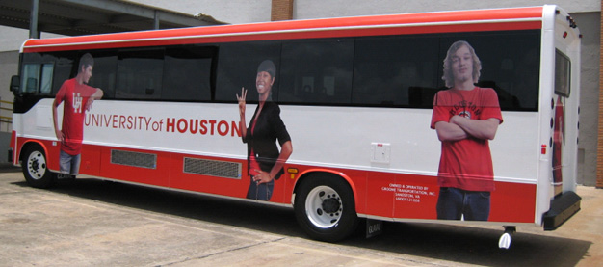
Where is the Tax Department?
Our offices are located at Energy Research Park, Building 1. The most convenient method of reaching our offices is to ride the ERP/Eastwood Shuttle. The shuttle stop can be found at the University Center. Please notify the bus driver, you need to stop at Building 1 (the LAST stop at ERP).
Elizabeth Giron, Room 113
Alma Villarreal, Room 115
To better serve you, we see visitors by appointment only between the hours of 8:30 a.m. – 3:00 p.m. To schedule an appointment, please send email request to Elizabeth Giron egiron@central.uh.edu

Slide 21

Picture Page Layout
If you have any questions, please contact us by email:
Alma Villarreal (avillare@central.uh.edu)
Elizabeth Giron (egiron@central.uh.edu)

